Slide 1
UMET9G-30-1 Accounting & Finance for Decision Making Financial Statement Analysis – part 1

Slide 2

Recap
So far we have covered:
An introduction to Finance and to accounting
Statement of Financial Performance
Income Statement
The accounting equation
Cash vs Profit
Notes:
NOTE TO STUDENTS: Please see last weeks lecture slides and make sure you review them so that you understand how you will be assessed and what resources we provide to support you in success.

Slide 3
Learning Outcomes
Understand the role of ratios
Understand the need for analysing and interpreting accounting information
Identify the different classifications of ratios
Demonstrate the use of profitability ratios and investment ratios

Slide 4
Financial Ratios
Express the relationship of one figure in the accounts to another, e.g. Operating Profit to Sales Revenue or Current Assets to Current Liabilities
Quick and simple to calculate and understand
Ratios allow to evaluate performance and financial health of companies
Financial tool allowing time series and cross sectional analysis
Notes:
Provide a brief definition of the ratio.
Comment how the ratio has changed in relation to the previous year or against a competitor/industry average.
State whether the change is favourable/unfavourable and provide justification.
4. Comment on the reasons for the change.

Slide 5
Why Use Ratios?
Businesses can be of different size and therefore direct comparison can be difficult.
By expressing figures in relation to each other, we remove the problem of comparing companies of different size.
A few ratios can give us a good basic idea of what is going on in the company.

Slide 6

Which Company Has Performed Better?
Company A Company B
Operating profit £250m £125m
Vs

Slide 7

Which Company Has Performed Better?
Company A Company B
Operating profit £250m £125m
Turnover £1,500m £500m
Shown as a % 17% 25%
Or in other words
£1 of sales equates to 17p 25p

Slide 8
Limitations
Ratios are backward looking.
Creative accounting and Different accounting policies
Ratios are only the starting point for further analysis.
They help to highlight financial strengths and weaknesses.
Ratios are only useful if you can make comparisons – company, industry, year on year
Only a detailed analysis of the underlying business/sector/economy will highlight the reasons for the changes in ratios.
Restricted vision – don’t forget the non-financial data
The accounts do not take into account the effects of inflation

Slide 9
The Key Steps of Ratio Analysis
Identify users and
their information
needs
Select and calculate
appropriate
ratios
Interpret and
evaluate the
results

Slide 10
Getting to Know Your Accounts
The financial statements tell us a “story” about company performance.
Look for obvious information from the financial statements
This helps to understand which ratios will be useful to calculate
This may pick up some issues the ratios may not be able to identify.
It may also pick up some points that could help us with our interpretation.
Start at the top of the statement of financial position.

Slide 11
Financial Ratio Classifications
Profitability Ratios, assess a company's ability to generate earnings relative to revenue, assets, equity, and other financial metrics
Investment Ratios, help shareholders to understand how the company is managing their investment
Efficiency Ratios, evaluate how effectively a company utilises its resources
Gearing (Leverage) Ratios, analyse the degree to which a company is financed by debt versus equity.
Liquidity Ratios, Measure a company's capacity to meet short-term obligations
Understanding these ratios provides insights into a company's operational efficiency, financial stability, and profitability, aiding stakeholders in making informed decisions.

Slide 12
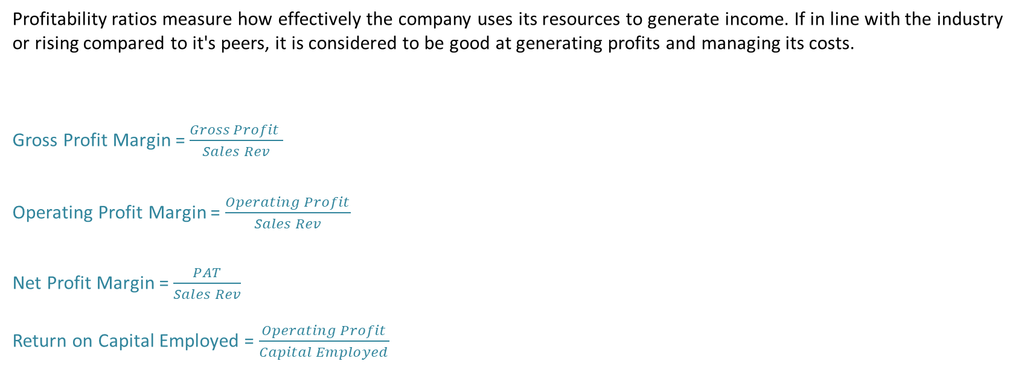
Profitability Ratios
Profitability ratios measure how effectively the company uses its resources to generate income. If in line with the industry or rising compared to it's peers, it is considered to be good at generating profits and managing its costs.
Gross Profit Margin = $\frac{Gross Profit }{Sales Rev}$
Operating Profit Margin = $\frac{Operating Profit}{Sales Rev}$
Net Profit Margin = $\frac{PAT}{Sales Rev}$
Return on Capital Employed = $\frac{Operating Profit}{Capital Employed}$
Notes:
GPM expresses the gross profit as a percentage of the sales revenue - Gross profit is the amount remaining after the cost of sales has been deducted from trading revenue (before day to day running costs are deducted). So GPM measures the profitability from buying and selling goods before we take into consideration other expenses, it considers competitive forces on selling prices, increase in material costs etc.
OPM profitability ratio that expresses the operating profit as a percentage of the sales revenue for the period. The operating profit represents the trading profit (if positive) before cost of servicing long term finance and tax are taken into account.
NPM is commonly used as it measures the proportion of each dollar of sales that is retained as profit after taxes. So this considers interest costs – i.e. the cost of debt.
The relationship of the OPM to the GPM, reflects the companies internal control over operating expenses.
ROCE profitability ratio that presents operating profit as a percentage of long term capital invested in the business. It is a fundamental indicator of companies performanceIf we have access to an opening and closing balance, we use the ‘average’ capital employed (beginning balance plus end of year balance & DIVIDE BY 2). It helps assess the effectiveness of capital allocation decisions and the ability to generate returns on invested capital.
The GPM was lower for Morrisons.
The OPM was slightly higher for Morrisons.
The NPM was higher for Morrisons.
The ROCE was higher for Morrisons.
Whilst Morrisons operate at a lower Gross Profit Margin, they make up for this; showing tighter control of operating and finance expenses. The ROCE is higher for Morrison’s suggesting it is generating greater profit from its capital.

Slide 13
Financial Statements Cross Sectional Analysis – Morrison’s vs Sainsbury’s
SoFP
Assets | 2020 (£m) |  | Liabilities and Equity | 2020 (£m)
 | Morrisons | Sainsbury's |  | Morrisons | Sainsbury's
Current Assets |  |  | Current Liabilities
Cash | 305 | 1,055 | Accounts payable | - | 10,658
Cash equivalents | - | 557 | Accrued expenses and other | 3,396 | 1,389
Inventories | 660 | 1,732 | Unearned revenue | - | -
Accounts receivable, net | - | 811 | Total Current Liabilities | 3,396 | 12,047
Total Current Assets | 1,322 | 7,586 | Long-term debt | 2,983 | 8,117
Property and equipment, net | 9,598 | 20,351 | Shareholders’ equity | 3,012 | 3,705
Other assets | - | - | Retained Earnings | 1,529 | 4,068
Total Assets | 10,920 | 27,937 | Total Liabilities and Equity | 10,920 | 27,937

Slide 14
Cross Sectional Analysis – Morrison’s vs Sainsbury’s
IS
 | 2020 (£m)
 | Morrisons | Sainsbury's
Sales | 17,536 | 28,993
– Cost of goods sold | 16,907 | 26,977
Gross Profit | 629 | 2,016
– Selling, administrative and other expenses | 174 | 1,366
Earnings Before Interest and Taxes (EBIT) | 455 | 650
– Interest expenses | 20 | 395
Earnings Before Taxes (EBT) | 435 | 255
– Taxes | 87 | 103
Net Income | 348 | 152

Slide 15
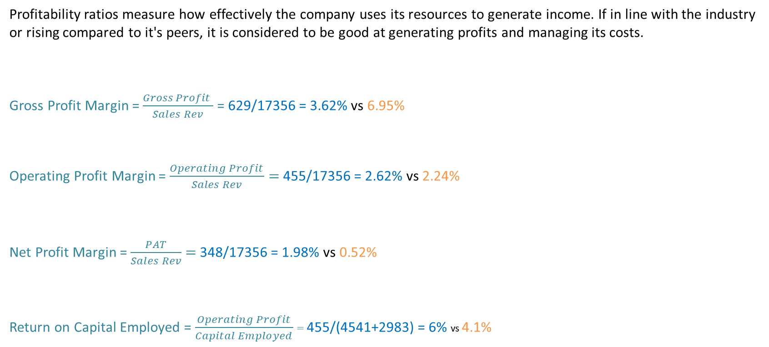
Profitability Ratios – Morrison’s vs Sainsbury’s
Profitability ratios measure how effectively the company uses its resources to generate income. If in line with the industry or rising compared to it's peers, it is considered to be good at generating profits and managing its costs.
Gross Profit Margin = $\frac{Gross Profit }{Sales Rev}$ = 629/17356 = 3.62% vs 6.95%
Operating Profit Margin = $\frac{Operating Profit}{Sales Rev}=$ 455/17356 = 2.62% vs 2.24%
Net Profit Margin = $\frac{PAT}{Sales Rev}$ $=$ 348/17356 = 1.98% vs 0.52%
Return on Capital Employed = $\frac{Operating Profit}{Capital Employed}$ $=$ 455/(4541+2983) = 6% vs 4.1%
GP = Revenue - COGS
OP = GP - OPEX
NP = PAT or “Earnings”
CE = Equity + NCL OR Assets-CL
Notes:
The GPM was lower for Morrisons.
The OPM was slightly higher for Morrisons.
The NPM was higher for Morrisons.
The ROCE was higher for Morrisons.
Whilst Morrisons operate at a lower Gross Profit Margin, they make up for this; showing tighter control of operating and finance expenses. The ROCE is higher for Morrison’s suggesting it is generating greater profit from its capital.

Slide 16
Financial Statements Time Series Analysis – Wholesale Carpet SoFP
 | 2023 |  | 2024
 | £000 | £000 | £000 | £000
Non-current Assets
Property plant and equipment (cost less depreciation)
Freehold land and buildings | 381 |  | 427
Fixtures and fittings | 129 |  | 160
 |  | 510 |  | 587
Current Assets
Inventories at cost | 300 |  | 406
Trade Receivables | 240 |  | 273
Cash at bank | 4 |  | -
 |  | 544 |  | 679
TOTAL ASSETS |  | 1,054 |  | 1,266
EQUITY AND LIABILITIES:
Equity
Share capital £0.50 ordinary shares |  | 300 |  | 300
Retained earnings |  | 263 |  | 234
 |  | 563 |  | 534
Non-current Liabilities
Borrowings 9% debentures (secured) |  | 200 |  | 300
Current Liabilities
Trade payables | 261 |  | 354
Corporation tax due | 30 |  | 2
Bank Overdraft | - |  | 76
 |  | 291 |  | 432
TOTAL EQUITY AND LIABILITIES |  | 1,054 |  | 1,266
 | 2023 |  | 2024
 | £000 | £000 | £000 | £000
Non-current Assets
Property plant and equipment (cost less depreciation)
Freehold land and buildings | 381 |  | 427
Fixtures and fittings | 129 |  | 160
 |  | 510 |  | 587
Current Assets
Inventories at cost | 300 |  | 406
Trade Receivables | 240 |  | 273
Cash at bank | 4 |  | -
 |  | 544 |  | 679
TOTAL ASSETS |  | 1,054 |  | 1,266
EQUITY AND LIABILITIES:
Equity
Share capital £0.50 ordinary shares |  | 300 |  | 300
Retained earnings |  | 263 |  | 234
 |  | 563 |  | 534
Non-current Liabilities
Borrowings 9% debentures (secured) |  | 200 |  | 300
Current Liabilities
Trade payables | 261 |  | 354
Corporation tax due | 30 |  | 2
Bank Overdraft | - |  | 76
 |  | 291 |  | 432
TOTAL EQUITY AND LIABILITIES |  | 1,054 |  | 1,266

Slide 17
Financial Statements Time Series Analysis – Wholesale Carpet
 | 2023 |  | 2024
 | £000 | £000 | £000 | £000
Non-current Assets
Property plant and equipment (cost less depreciation)
Freehold land and buildings | 381 |  | 427
Fixtures and fittings | 129 |  | 160
 |  | 510 |  | 587
Current Assets
Inventories at cost | 300 |  | 406
Trade Receivables | 240 |  | 273
Cash at bank | 4 |  | -
 |  | 544 |  | 679
TOTAL ASSETS |  | 1,054 |  | 1,266
EQUITY AND LIABILITIES:
Equity
Share capital £0.50 ordinary shares |  | 300 |  | 300
Retained earnings |  | 263 |  | 234
 |  | 563 |  | 534
Non-current Liabilities
Borrowings 9% debentures (secured) |  | 200 |  | 300
Current Liabilities
Trade payables | 261 |  | 354
Corporation tax due | 30 |  | 2
Bank Overdraft | - |  | 76
 |  | 291 |  | 432
TOTAL EQUITY AND LIABILITIES |  | 1,054 |  | 1,266
IS
 | 2023 |  | 2024
 | £000 | £000 | £000 | £000
Sales Revenue |  | 2,240 |  | 2,681
Less cost of sales
Opening inventories | 241 |  | 300
Plus purchases | 1,804 |  | 2,378
Less closing inventories | (300) | (1,745) | (406) | (2,272)
Gross Profit |  | 495 |  | 409
Less Operating costs |  | (252) |  | (362)
Operating Profit (PBIT) |  | 243 |  | 47
Less finance costs |  | (18) |  | (32)
Profit before tax |  | 225 |  | 15
Corporation tax |  | (60) |  | (4)
Profit for the year |  | 165 |  | 11
Additional Information:
All sales and purchases in the company are on credit. The market value of each share was £2.50 in 2023 and £1.50 in 2024.
At 31 March 2022, the trade receivables stood at £223,000 and the trade payables at £203,000.
A dividend of £40,000 had been paid to the shareholders in respect of each of the years.
At 1 April 2022, the total of equity stood at £438,000 and the total of equity and non-current liabilities stood at £638,000.

Slide 18
Time Series Analysis - Wholesale Carpet Profitability Ratios
2020 2019
Return on Capital Employed 5.9% 34.7%
Gross Profit Margin 15.3% 22.1%
Operating Profit Margin 1.8% 10.8%
Notes:
Use the decline in ROCE was 28.8%.
The decline in the operating profit margin was 9% and the decline in the gross profit margin was only 6.8%.
Thus conclude increase in operating expenses between 2019 and 2020.
Thus decline in ROCE was due partly to increase in inventory values and partly to increase in operating costs- why?
Look at planned levels and industry average.

Slide 19
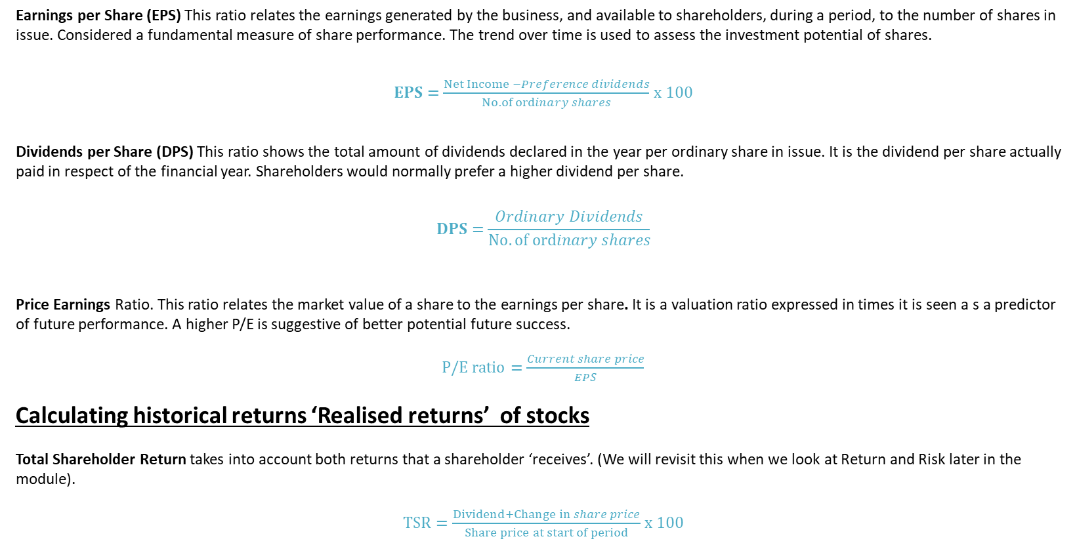
Investment Ratios
Earnings per Share (EPS) This ratio relates the earnings generated by the business, and available to shareholders, during a period, to the number of shares in issue. Considered a fundamental measure of share performance. The trend over time is used to assess the investment potential of shares.
$EPS=\frac{Net Income −Preference dividends}{No. of ordinary shares}$ x 100
Dividends per Share (DPS) This ratio shows the total amount of dividends declared in the year per ordinary share in issue. It is the dividend per share actually paid in respect of the financial year. Shareholders would normally prefer a higher dividend per share.
$$DPS=\frac{Ordinary Dividends}{No. of ordinary shares}$$
Price Earnings Ratio. This ratio relates the market value of a share to the earnings per share. It is a valuation ratio expressed in times it is seen a s a predictor of future performance. A higher P/E is suggestive of better potential future success.
P/E $ratio=\frac{Current share price}{EPS}$
Calculating historical returns ‘Realised returns’ of stocks
Total Shareholder Return takes into account both returns that a shareholder ‘receives’. (We will revisit this when we look at Return and Risk later in the module).
T$SR=\frac{Dividend+Change in share price}{Share price at start of period}$ x 100

Slide 20
Summary of Investment Ratios
Notes:
The earnings per share ratio has fallen dramatically.
However the dividend per share has remained constant- Why??
The share price has fallen but is still higher than we might expect – Why?
These ratios are the main way the company communicates with the shareholders.

Slide 21
Average P/E Ratios

Slide 22
Conclusion
Financial ratios allow performance evaluation
Useful and easy tool
Highlight the problem but may not always explain the reasons behind the problem
Profitability ratios – some of the key financial ratios
Next week – Gearing, liquidity and efficiency ratios
Notes:
Consider the sector and the performance of the company in relation to the sector
Supermarket- low profit margin.
Jeweller- high profit margin.
Profit margins will be squeezed in times of recession.

Slide 23
Learning Outcomes Covered
Understand the role of ratios
Understand the need for analysing and interpreting accounting information
Identify the different classifications of ratios
Demonstrate the use of profitability ratios and investment ratios

Slide 24
Next Week
Gearing, Liquidity and Efficiency ratios

